Slide 1


Algorithm for Avoiding Street Harassment by Using Secure Routes

Slide 2


Presentation of the team
Mariana García
Investigator
Maria Camila Raigosa
Investigator
Isabella Márquez
Writer
https://github.com/httpsmariana/proyecto-1

Slide 3


Presentation of the team
Andrea Serna
Literature review
Mauricio Toro
Data preparation
https://github.com/httpsmariana/proyecto-1

Slide 4
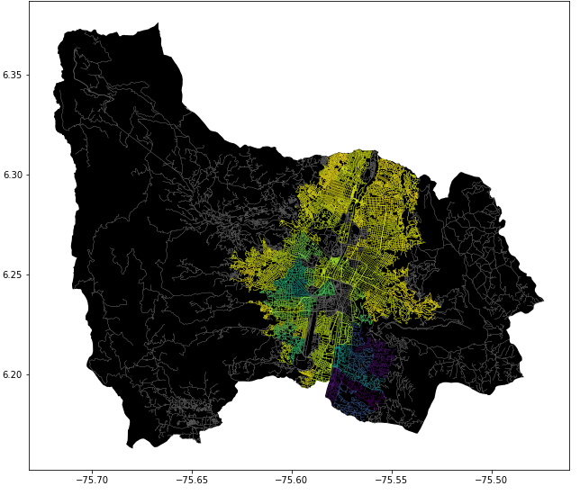
Problem Statement
Shortest path algorithm
Streets
of Medellín, Origin and Destination
Three paths that reduce both the risk of harassment and distance

Slide 5
Solution Algorithm
Dijkstra
Algorithm
Streets
of Medellín, Origin and Destination
A path that reduces both distance and harassment

Slide 6
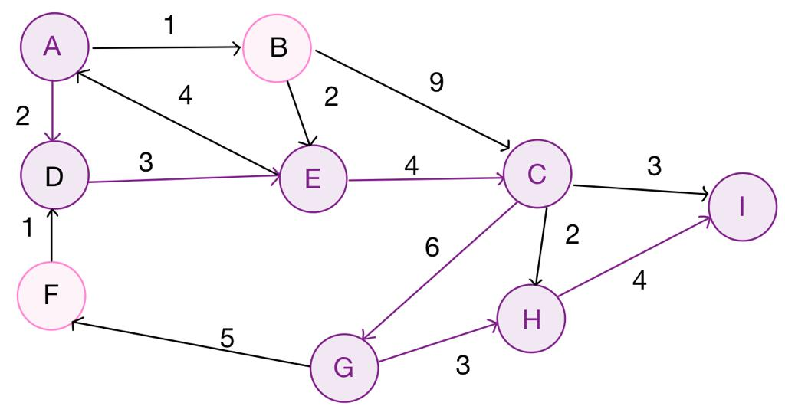
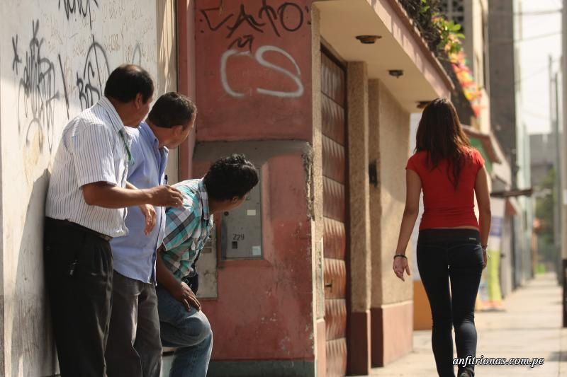
Explanation of the algorithm
Dijkstra Algorithm
in the graph we can see how the algorithm demarcates the fastest and safest route by evaluating the possible cases and states of the routes.

Slide 7

Complexity of the algorithm
 | Time complexity | Complexity of memory
Dijkstra | O(V²) | O(V)
Time and memory complexity of the algorithm name. V is...E is... (In this semester, it could be DFS, BFS, Dijkstra, A*). Please explain what V and E mean in this problem. PLEASE, it is not helpful to put 'n'.
Explain the tables in your
own words
Use superscripts to represent exponents. Do NOT use the ^ symbol.

Slide 8
First path minimizing v = r+d
.
Origin | Destination | Distance (meters) | Risk of harassment (between 0 and 1)
EAFIT University | National University | 2577 m | 29
Distance and risk of harassment for the path that minimizes v = r+d in which d represents distance, and r represents risk. Execution time of 49 seconds.

Slide 9
Second path minimizing v = r^d
Origin | Destination | Distance (meters) | Risk of harassment (between 0 and 1)
EAFIT University | National University | 6419 m | 59
Distance and risk of harassment for the path that minimizes v = r^d which d represents distance, and r represents risk. Execution time of 39 seconds.

Slide 10
Third path minimizing v = r * 3267 + d * 1234
Origin | Destination | Distance (meters) | Risk of harassment (between 0 and 1)
EAFIT University | National University | 2579 m | 28
Distance and risk of harassment for the path that minimizes v = r * 3267 + d * 1234 which d represents distance, and r represents risk. Execution time of 45 seconds.

Slide 11
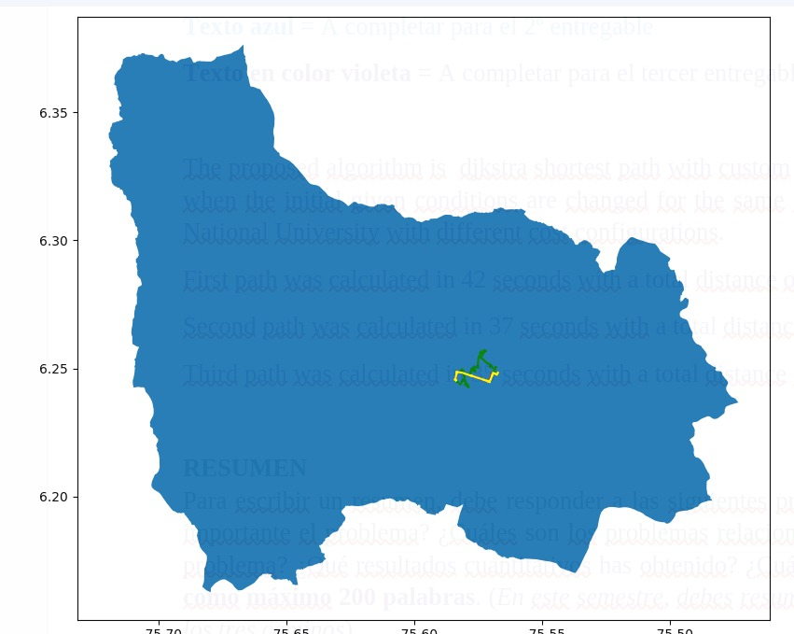
Visual comparison of the three paths

Slide 12

Future work directions
Databases
Project 1
Software Engineering
Project 2
Other variables to take into account
Mobile application
Connections to bigger companies
Web implementation
.

Slide 13

THANK YOU!!!
With the support of
All authors are grateful to the Vice Rector's Office for Discovery and Creation, Universidad EAFIT, for their support in this research.

